Slide 1
Embedded C program for interfacing a LED and switch with STM32

Slide 2
Objectives
Read the status of the switch.
If the switch Is on, turn on the LED.
If the switch is off, turn off the LED.

Slide 3
Steps for programming STM32
Enable clock for necessary ports.
Reset the GPIO’s that are to be used.
Configure the GPIO’s for input/ output.
Reset the PUPDR register for necessary pins.
Configure the necessary pins for PULL UP/ PULL DOWN with PUPDR.
Read necessary IDR values and actuate peripherals by configuring necessary ODR’s.

Slide 4
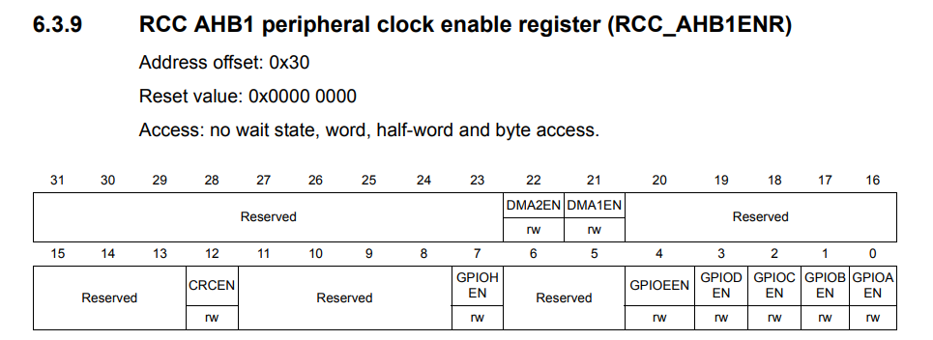
Enabling Clock
RCC->AHB1ENR = 0X00000001;
Let us use GPIOA for all the operations

Slide 5
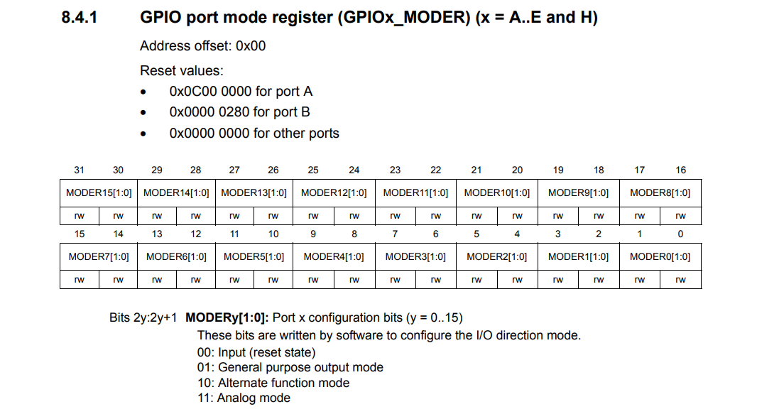

Slide 6
How to Write a value into a register?
GPIOA->MODER = 0X00000001; //which means PA.0 is output
Now if I want PA.3 to be as output then
GPIOA->MODER = 0X00000040;
This will configure PA.3 as output but remove the previous configuration of PA.0.
Instead we can use “&=~” combination read as “and assigned with negation of” to reset necessary ports.
We can use “|=“ combination read as “or assigned with” to configure to required mode.

Slide 7
How to Write a value into a register?
Objective: make PA.0 as output and PA.1 as input
Steps:
Reset the MODER register of port A pertaining to PA.0 and PA.1.
A moder state of “00” for a particular pin is assumed to be the reset state.
GPIOA->MODER&=~0X0000000F;
Configure the MODER register of port A for PA.0 as o/p and PA.1 as i/p
“01” for a pin is treated as output.
“00” for a pin is treated as input.
GPIOA->MODER |= 0X00000001;

Slide 8
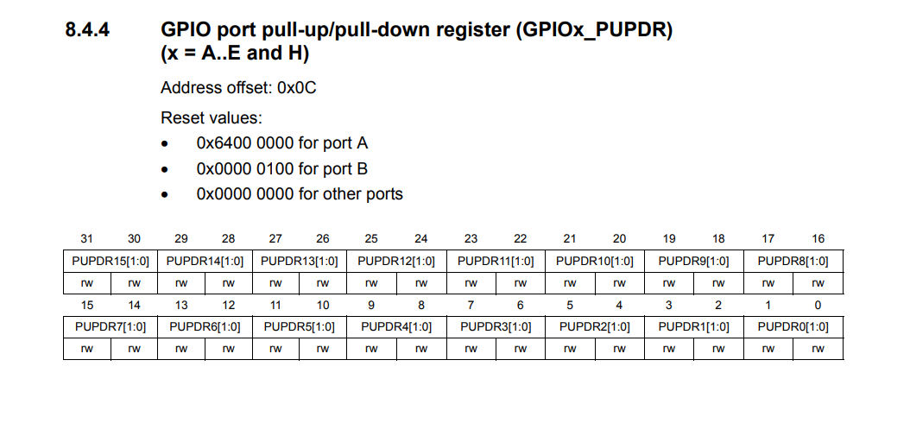

Slide 9
Configuring pull up and pull down registers
Why should I configure PUPDR?
When I don’t press the switch, the default value of the switch is depended on whether the pin is pulled up or pulled down.
What are the default values?
Pulled up pin: Default value is “0”.
Pulled down pin: Default value is “1”.
“00” is for No pull up No pull down
“01” is for Pull-Up
“10” is for Pull-Down
“11” is Reserved
Reset PUPDR
GPIOA->PUPDR&=~0x0000000C;
Configure PUPDR
GPIOA->PUPDR|=0X00000004

Slide 10
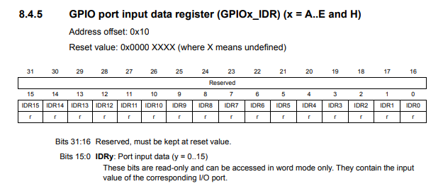
Monitoring IDR
Read data from IDR
First construct the monitoring bit, here IDR1 must be 1 to monitor the state of IDR1 we have to perform bitwise and with IDR register
Flag = GPIOA->IDR & 0X00000002;

Slide 11
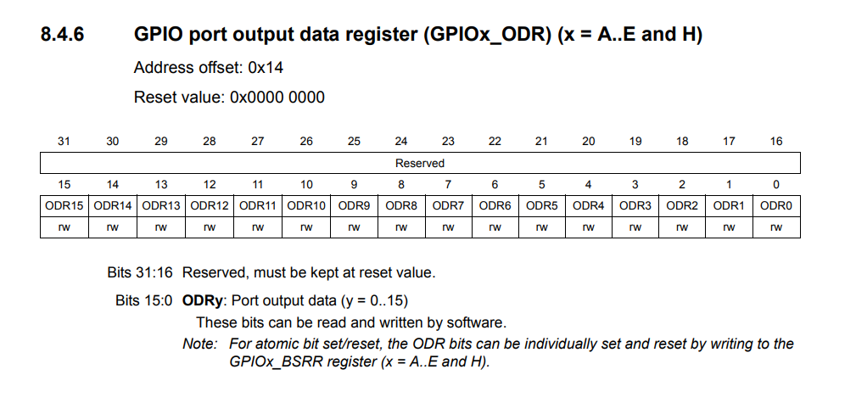
Configuring ODR
Make the respective ODR of PA.0 which is ODR0 as “1” if flag is 0 (pulled up pin)
If(!flag)
GPIOA->ODR |=0X00000001;
else
GPIOA->ODR |=0X00000001;

Slide 12
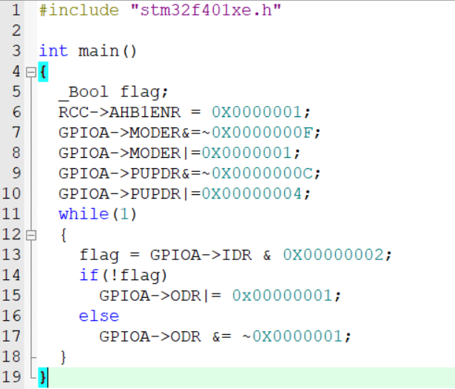
Final Code

Slide 13

Please Subscribe to my channel……..
Like Share Comment Subscribe

